Slide 1
Task-1
Codtech IT Solutions
(Internship)
Sangram Sonawane

Slide 2
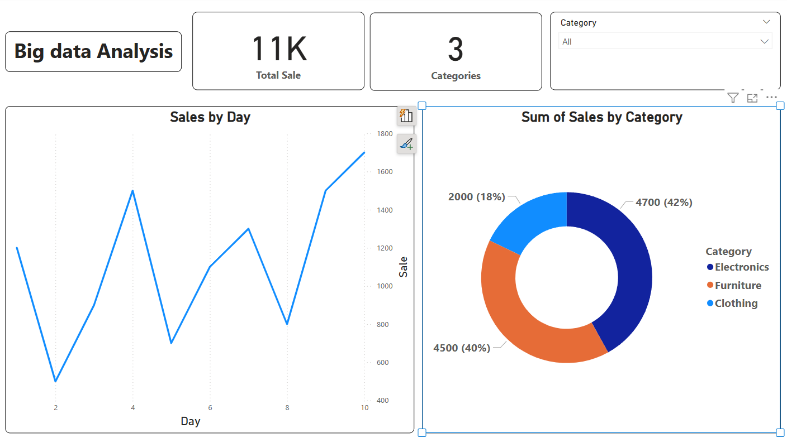

Slide 3
Report :
Overall sale of all the categories --- 11K
No. of categories --- 03
Sales of Electronic category --- 4700 (42%)
Sales of Furniture category --- 4500 (40%)
Sales of Clothing category --- 2000 (18%)
Furniture category has highest sales by day

